Slide 1
UE18CS390B – Capstone Project Phase – 2
Project Progress Review #2
Project Title : Community detection in dynamic networks.
Project ID : 77
Project Guide : Prof. Sreenath MV
Project Team :
Name | SRN
Mahammad Thufail | PES2201800646
Manne Vasanth | PES2201800425
Purushotham S | PES2201800480
Pulle Manikya Sri Manasa | PES2201800468

Slide 2
Outline
Abstract and Scope of the Project.
Suggestions from Review – 1.
Approach & Architectural Design or Framework.
Project Progress and Demonstration.
Timeline for Pending Tasks.
Conclusion.
References.

Slide 3
Abstract and Scope
We are using an approach that will allow us to find clusters of similar terror groups using information on their operational characteristics. Specifically, using open access data of terrorist attacks occurred worldwide since 1970, we are trying to build network that includes terrorist groups and related information on tactics, weapons, targets, active regions.
We model this data with each partition joined to the terrorist groups. Later on we will find the most influential group with maximum number of relations between other networks and try to prevent the attacks .Community detection to identify sets of nodes in such a way that the connections of nodes within a set are more than their connection to other network nodes.

Slide 4
Suggestions from Review - 1
To use a proper feature Selection Technique.
Preprocess the GTD dataset in such a way that all the preprocessed steps are justified properly.

Slide 5
Proposed Approach / Methodology
Designing the terrorist groups network:
The first move is to construct the terrorist group's network. The network-building algorithm is fairly straightforward. Assume W = (V, E), with W representing the terrorist group's network, V representing the network's nodes, and E = V X V representing the network's borders.

Slide 6
Proposed Approach / Methodology
Finding influential nodes:
Degree centrality is defined as the number of links incident upon a node (i.e., the number of ties that a node has). If the network is directed (meaning that ties have direction), then two separate measures of degree centrality are defined, namely, indegree and outdegree.
An edge with a high edge betweenness centrality score represents a bridge-like connector between two parts of a network, and the removal of which may affect the communication between many pairs of nodes through the shortest paths between them.
Eigenvector centrality is used to measure the level of influence of a node within a network. Each node within the network will be given a score or value: the higher the score the greater the level of influence within the network. This score is relative to the number of connections a node will have to other nodes. Connections to high-scoring eigenvector centrality nodes contribute more to the score of the node than equal connections to low-scoring nodes.

Slide 7
Proposed Approach / Methodology
Community Detection in social networks : Communities are calculated by maximizing the objective function in a two-step optimization in each one of the iterations.
Louvain algorithm using locality modularity optimization:
In the first step, small communities are formed by optimizing the modularity locally. Only local changes of communities are allowed in this step.
In the following step, nodes belonging to the same community are aggregated in a single node that represents a community in a new aggregated network of communities.
Iteratively these steps are repeated until no increase in modularity is possible with a hierarchy of communities being produced.
Once the original algorithm does not allow the addition or removal of new nodes and edges after obtaining the community structure, a re-computation of the communities starting from an initial network is necessary.

Slide 8
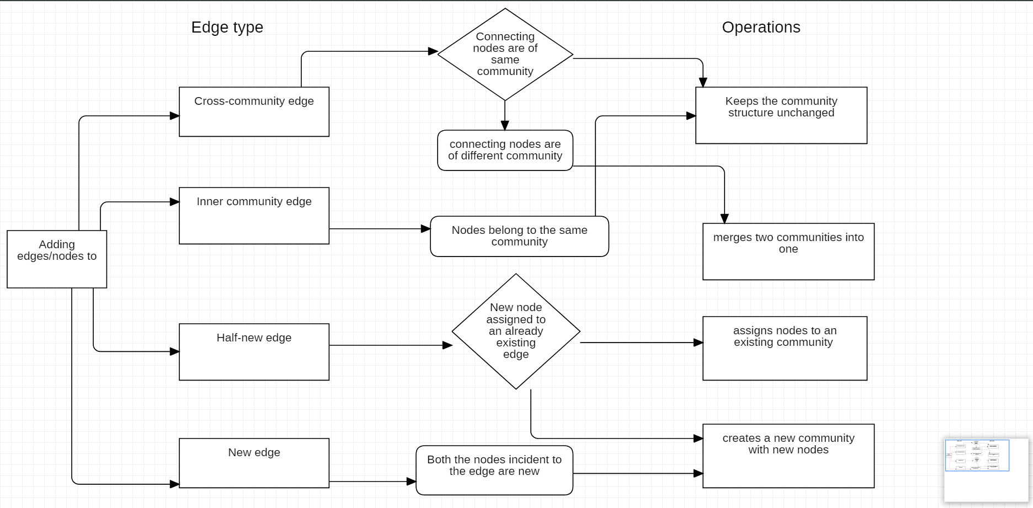
Proposed Approach / Methodology
Adding nodes/edges:

Slide 9
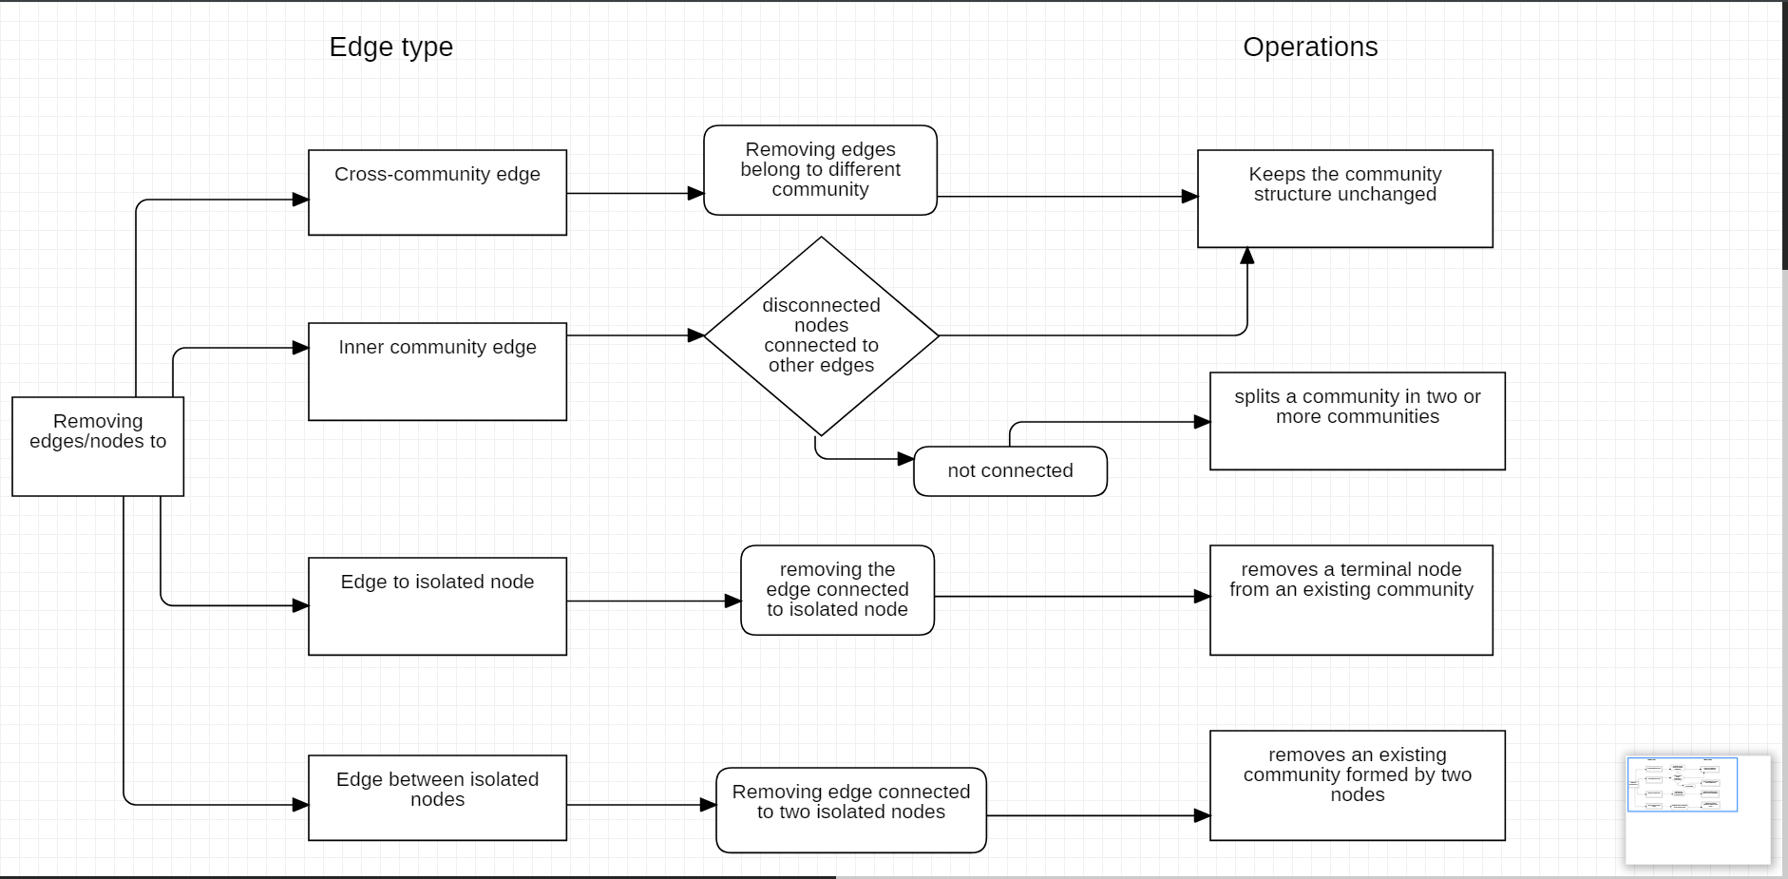
Proposed Approach / Methodology
Removing nodes/edges:

Slide 10
Proposed Approach / Methodology
To enable true dynamic graph community detection, the Louvain Method was modified to support incremental community structure changes when nodes are added or removed from the network.
The quality of communities obtained by the Dynamic Louvain in the incremental network scenario had a slightly higher variance in modularity compared to the original Louvain.
Why this algorithm is better:
Optimization: Our algorithm only performs community detection in the full network only at the first snapshot.
Efficiency: The modified Louvain steps will only compute communities which are affected by addition or removal of nodes/edges.
Stability: In the proposed algorithm, unaffected communities keep unchanged. Therefore, they preserve the same nodes and even the same community id between snapshots.

Slide 11
Design Details
Novelty:
The prediction of terrorist network and identifying main actors is an important issue for intelligence and security informatics, and few of the researches lack in this aspect. So we propose a method to analyze social network using some machine learning techniques (ie.,K-Core Concepts). Once the networks are clustred accordingly then we then use methodology based on community detection to determine the relationships of the terrorist node within the same cluster as well as the terrorist nodes from different clusters.
Innovativeness:
The approach that we proposed elicits terrorist group’s networks, finds most influential nodes and temporal evolution of terrorist networks, but it is not an open-source model instead these data are shared with national intelligent management for protecting nation from terrorist threats and implement counter terrorism activity.

Slide 12
Design Details
Performance:
Performance is also the main aspect of this approach, because the approach that we proposed has a better efficiency since we measure it by considering the number of nodes that can instantly access a large number of different nodes through a relatively small number of ties. The nodes are treated as nonredundant contacts.
Maintainability:
We need to use a good ranking methods and algorithms to make sure it is showing right results to the users. We would also assign weights to the nodes so that there will be change in importance of identifying the community accordingly as the time goes on. These ranking methods have to be tested and updated time to time to ensure good working of the tool. The retrieval of results from the underlying search engines is achieved using their respective API’s which are free of cost. Maintenance would be required if their respective policies changes.

Slide 13
Design Details
Reliability:
The algorithm we use is capable of performing operations using the data got from the terrorist database and is producing results in a time which we could think of other tasks to perform. It is reliable for the kind of data we use and the efficient results produced at the end.
Legacy to modernization:
To gain operational efficiencies as per the legacy modernization we are updating and optimizing business systems by enabling graphical access to government agencies who could actually view each community growth and the influential node in a single display graphical view. This makes user achieve their expectations in their experience and getting easily adopted to other newer technology platforms.

Slide 14
Design Details
Application compatibility:
As our project is capable of operating in different operating systems and its environment is also user-friendly, it allow us to automate the process of testing where all the application is tested for their compatibility at once. Enabling auto removing of the features which is not supported by the operating system is achieved to a certain extent.
Resource Utilization:
There is huge data to be processed and most of it are not needed for the kind of results we expect. So we kind of use only the results which has huge impact on terrorist growth and which also needed for the future link prediction among the groups. The community detection almost enables us to know the relation between different communities and their growth over time. So the data is utilized as per our intermediate needs and predictions.

Slide 15
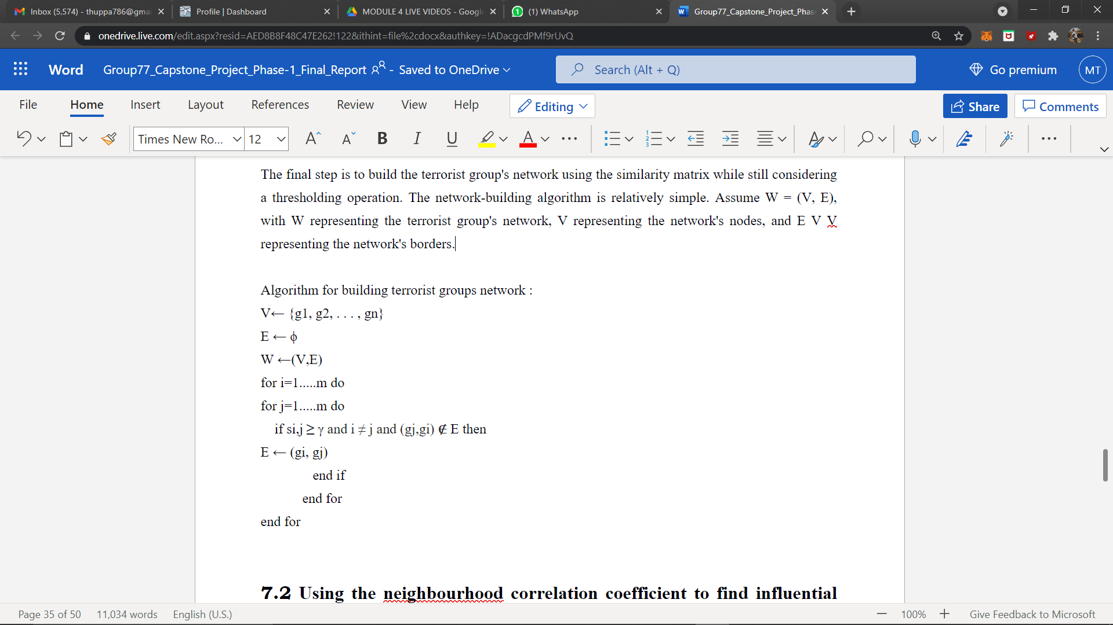
Algorithm & Pseudocode
Algorithm for building terrorist groups network:

Slide 16
Project Progress So far
The project progress so far:
We have completed the implementation part of building a network using the GTD dataset, then we found influential nodes among them using centerality measures.
Using the network that are been created , we performed community detection using Louvain algorithm.
The percentage completion of the project:
Till now 80% of our project is completed.

Slide 17
Project Demonstration
Prepare for a demo of the project:
Need to show working of some portions of the project individually
Data set creation needs to be demoed wherever applicable

Slide 18
Capstone (Phase-I & Phase-II) Project Timeline
March 9 2021
March 25 2021
April 9 2021
Finalising the Algorithm
Literature Survey
Finalising requirements for the project
Discussing and finalising the approach and understanding required technology
Working on part 1 of the project
Timeline on Deliverable-1

Slide 19
Capstone (Phase-I & Phase-II) Project Timeline
June 25 2021
Sep 15 2021
Nov 15 2021
Partial implementation of model
Final implementation
Present final system and start working on making a research paper
Submit the project for review and make journal on our implementation of project.
Timeline on Deliverable-2

Slide 20
Conclusion
Summarize the key points.
To understand the composition and evolution of terrorist networks we built the network using networkx , then we will find influential nodes based on centrality measures.
Degree centrality is defined as the number of links incident upon a node which finds the important node in the network. An edge with a high edge betweenness centrality score represents a bridge-like connector between two parts of a network which calculates the best connector in the network. Eigenvector centrality is used to measure the level of influence of a node within a network which gives the most influential node I the network. Finally for Community Detection we use Louvain algorithm using locality modularity optimization and detect communities in the network.

Slide 21
References
Understanding the composition and evolution of terrorist group networks: A rough set approach.
Authors : Vincenzo Loia, Francesco Orciuoli
https://www.sciencedirect.com/science/article/pii/S0167739X19307757
Finding influential nodes in social networks based on neighborhood correlation coefficient.
Authors : Ahmad Zareie, Amir Sheikhahmadi, Mahdi Jalili, Mohammad Sajjad Khaksar Fasaei
https://www.sciencedirect.com/science/article/pii/S0950705120300630
Community detection in large‑scale social networks: state‑of‑the‑art and future directions
Authors : Mehdi Azaouzi, Delel Rhouma, Lotf Ben Romdhane
https://www.sciencedirect.com/science/article/pii/S0020025517310101

Slide 22
Thank You

